Slide 1
Boosting Algorithm
Assignment

Slide 2
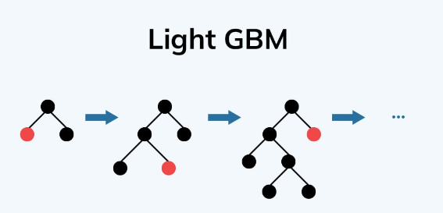
LGBoost
- Its a distributed high-performance framework that uses decision trees for ranking, classification, and regression tasks

Slide 3
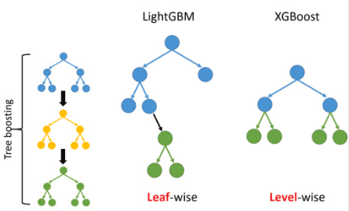
LGBoost
- Carries out leaf-wise (vertical) growth that results in more loss reduction and in turn higher accuracy while being faster

Slide 4
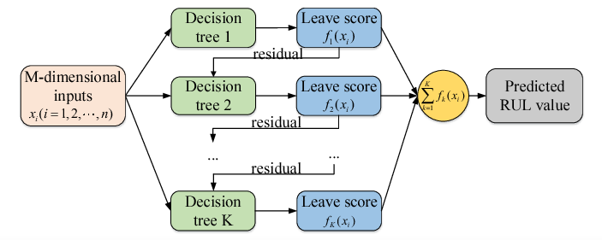
LGBoost

